Slide 1

NB NAVALE SINHGAD COLLEGE OF ENGINEERING ,SOLAPUR
UNIVERSITY OF PUNYASHLOK AHILYADEVI HOLKAR SOLAPUR
DEPARTMENT OF COMPUTER SCIENCE AND ENGINEERING
UNIVERSITY RESULT LEDGER SHEET ANALYSIS
A Project By:
1. Mr. Nageshkumar Mhetre Roll no 44
2. Mr. Sandeep Posham Roll no 45
3. Mr. Vitthal Narayankar Roll no 46
4. Mr. Sadguru Katakdhond Roll no 47
Project Guide:
Prof H.T. Gurme
(Department of CSE)

Slide 2
ABSTRACT
The traditional way used by universities or colleges to analyze the performance of students is time consuming and inconvenient.
So we need a new approach to analyze student’s overall performance.
To analyze the student’s data (marks) the data should be in particular format on which we can perform analysis.
The purpose of this project is to provide an easy way that can help to analyze result of each student.
Generally universities declare the results in PDF format.
The analysis of data in PDF file format become difficult, because it needs a manual way for analysis. Manual way is always very time consuming and sometimes need to prepare a new Excel file by manually entering data from PDF to Excel file.
For an educational institute analysis of student’s data is very important for continuous growth of students. Analysis of data becomes easier in Excel spread sheet. So this program transform the data of PDF file to Excel spread sheet, So further analysis on data will become easy.

Slide 3
Contents:
INTRODUCTION
SYSTEM DESIGN
SCOPE AND OBJECTIVE
PROBLEM STATEMENT
REQUIREMENT SPECIFICATION
CONCLUSION
BIBLIOGRAPHY

Slide 4
INTRODUCTION:
PDF is a versatile document format, but it can be difficult to read and edit it. To easily extract a table or edit text in a spreadsheet format, you can to convert PDF to editable Excel spreadsheets. There few applications or online PDF to Excel convertors, but these applications convert the whole PDF in Excel. Many of the times PDF has some irrelevant data that also get converted to Excel.
To perform analysis the data must be in appropriate format with required relevant data.
An Excel/CSV file store the data in tabular form that helps analyst to analyze data without any difficulty on other hand these things cannot be performed on PDF. Traditionally data analysis performed on data in Excel/CSV, but there is not a reliable way available to get PDF data into Excel.

Slide 5
Scope and Objective
Students and staff will be able to analyze result of students and get the overall status of each student.
It is very easy and best way to manage and display the result as per the performance of the students.
One can easily analyze the result and compare.
User friendly and hassle free for the sides.

Slide 6
Problem statement
To find efficient way to provide the PDF result data in tabular format and compare the performance of students by analyzing the data.

Slide 7
REQUIREMENT SPECIFICATION
HARDWARE REQUIREMENTS
2 GB or above
CPU :- PENTIUM 4 and above
Display :- Any Device
SOFTWARE REQUIREMENTS
Operating System :- Windows / Linux
Developing Tool :- Python 3.0, Pycharm/Anaconda (IDE)
Libraries :- PyPDF2, Numpy

Slide 8
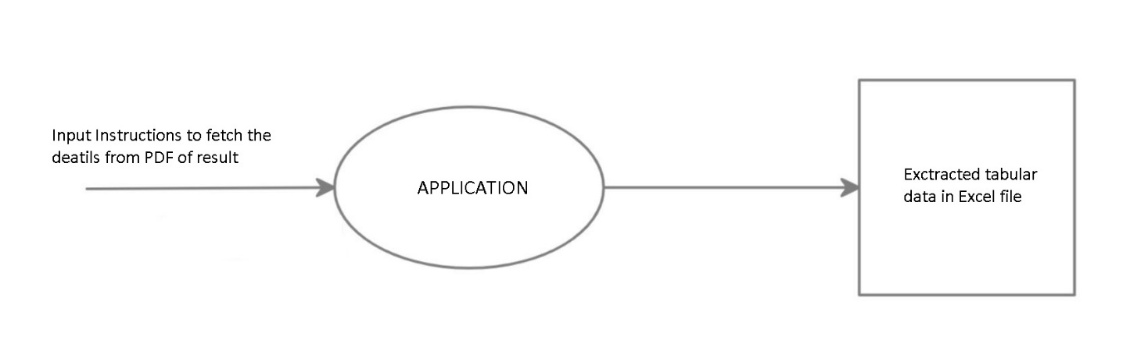
System design
DFD Level 0

Slide 9
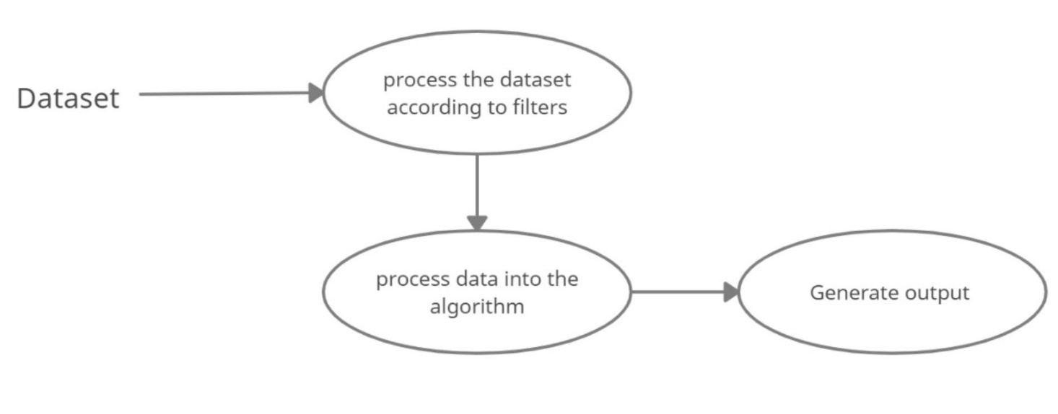
System design
DFD Level 1:

Slide 10
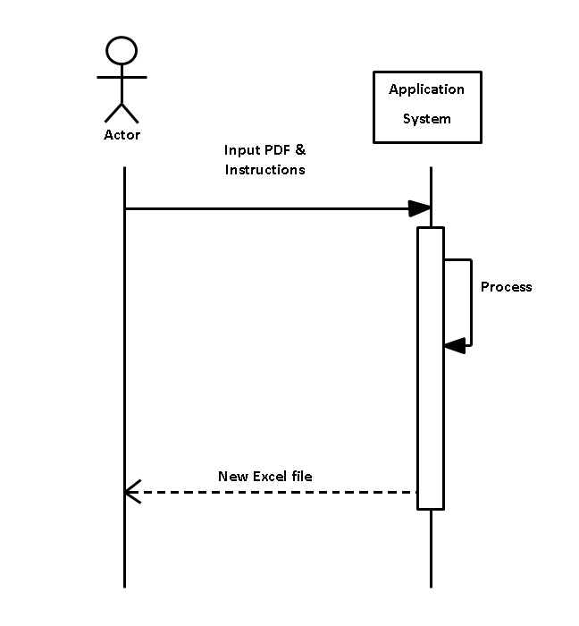
Sequence Diagram

Slide 11
METHODOLOGY
University declares the result which is in the format of ledger sheet. If staff wants to analyze the result then it'll be difficult because the result is in the pdf format.
So in our project we are making the process of analysis easy. But we need data in tubular form like excel/CSV to do analysis, so we're converting that pdf file into excel/CSV file so the user can analyze result of each student.
we're doing this project using python language and using ide as anaconda jupyter.
Python has libraries that helps to convert data from one file format to another.
We're currently using PyPDF2 and Numpy libraries for our project.

Slide 12
6.PyPDF2 is used for reading the data from pdf file and Numpy is used for working with arrays and lists that we are using for analysis.
7.At the beginning we take input file which is in the pdf format and we read all the data included in that file using PyPDF2 library.
8.Then we extract the only data which we required and store it in another file, after that we convert the data in the file in tables and there we do our final step as analysis.
9.In that we analyse student data such as marks gained by student in each subject,students percentage/sgpa, overall marks, etc.

Slide 13
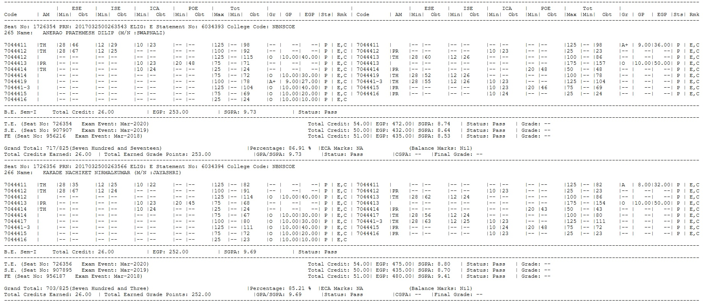
Project flow
Input:

Slide 14
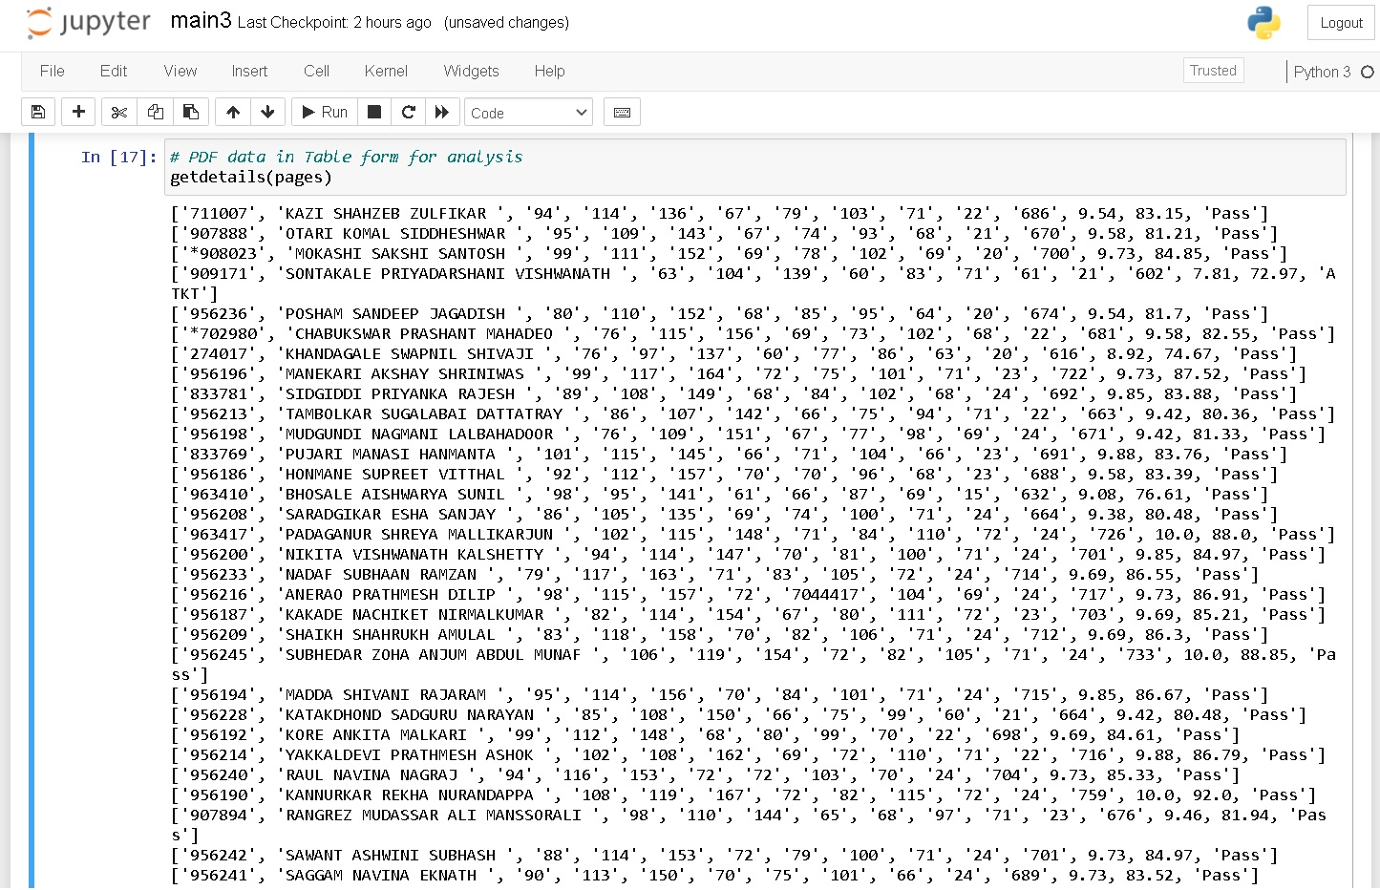
Extracted data from PDF file:

Slide 15
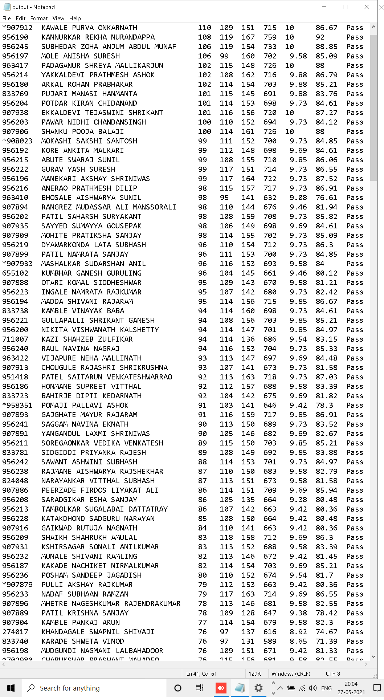
Output:

Slide 16
CONCLUSION:
In this project provides the final output based on analysis of students data available in PDF ledger sheet.

Slide 17
BIBLIOGRAPHY:
http://pypi.org
https://en.wikipedia.org/wiki/Data_transformation

Slide 18
THANK YOU

